Slide 1
Putting Together the ENJJPT SD Model

Slide 2
Purpose, Goals, and Assumptions
Purpose:
The purpose of this exercise is to create a full mapping of the ENJJPT pipeline from student entry to graduation of IFF.
Goal
To create a well documented, codable, and legible mapping of the process enabling commanders to make more informed decisions and to provide analysts the ability to predict changes to the system state.
Assumptions:
Every student, IP, commander, and staff member is intelligent, capable, and willing to put the effort in. That is, how hard one works is not a variable in the system model.

Slide 3
Basics of System Dynamics Modeling
A systems dynamic model is an approach using diagramming and math to represent complex systems as an aggregation of groups and relationships.
Models consist mainly of:
Stocks
Flows
Variables
Links

Slide 4
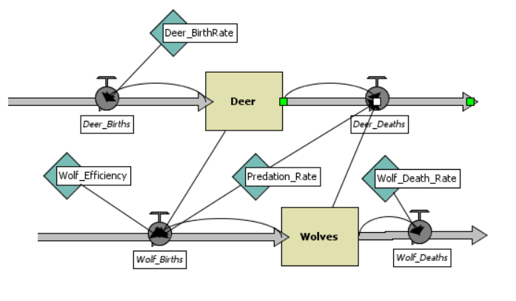
Learning the Basics Through an Example Model

Slide 5
Learning the Basics Through an Example Model:
Stocks
Think of stocks like a bucket. You can add to the bucket or take from it.
ENJJPT equivalent:
Students, IPs (all tiers), planes

Slide 6
Learning the Basics Through an Example Model:
Flows
Deer_Births= Deer*Deer_BirthRate
Deer_Deaths= Deer-Wolves*Predation Rate
A flow transports a material from one stock to another.
ENJJPT equivalent:
Completion of T6, DNIF, TDY, PCS, deployment, student graduation

Slide 7
Learning the Basics Through an Example Model:
Variables
A variable is a constant or dynamically calculated value that often affects flow.
ENJJPT equivalent:
Student refly rate, DNIF rates, Weather attrition rate, % chance an aircraft breaks

Slide 8
Learning the Basics Through an Example Model:
Links
A link establishes a direct relationship between objects. A link implies that those objects can be written together in a mathematical equation.
ENJJPT equivalent:
Linking IPs, students, and aircraft together to generate a sortie.

Slide 9
Going Forward, Here’s the Plan
The process will be split into three sections: T6, T38, and IFF
Dylan, AO, and Blake will each take one of the three sections
Erik will meet individually with each one when they are in the office all to help brainstorm and work on the model together (only for first time working on it)
Each section will initially be on its own Powerpoint slide within the same presentation
Start simple and expand the details later
First work on the stocks
Then work on the flows/relationships
Variables/Constants last
Boundaries are the other programs
Combine the programs and interleave the relationships
Document (i.e. where do the numbers come from?) and add data values where able (i.e. number of sorties in a syllabus)

Slide 10
Modeling/Diagrammatic Standard: (Stick to these principles)
Variables
Stocks
Link
+/-
Flows

Slide 11
Timeline
By 8 Mar, the team will have a semi-rough draft (2 iterations) of all models the individual programs
By 15 Mar the team will have a near final draft of the combined models and have sufficient documentation.
Sign off from Bursaw to workshop the flow/mapping around to other offices and receive feedback on it.
By 22 Mar the team will have incorporated feedback and finalized a presentable/printable version of the mapping with.
25-29 Mar the team will put together continuity write-ups for future LTs/analysis

